Slide 1

Struktur Data
Hashing
Prepared by
Frans Panduwinata, S.Kom, M.T

Slide 2

Introduction
Hashing
The technique used for ordering and accessing elements in a list in a relatively constant amount of time by manipulating the key to identify its location in the list.
Hash function
A function used to manipulate the key of an element in a list to identify its location in the list.

Slide 3
Introduction (cont)
EXAMPLE:
  A list of employees of a fairly small company.
  Each of the 100 employees has an ID number in the range 0 to 99, and we want to access the employee records using the key idNum.
  If we store the elements in an array that is indexed from 0 to 99, we can directly access any employee's record through the array index.
  There is a one-to-one correspondence between the element keys and the array index; in effect, the array index functions as the key of each element.

Slide 4
Introduction (cont)
EXAMPLE: (cont)
  In practice, however, this perfect relationship between the key value and the location of an element is not easy to establish or maintain.
  Consider a similar small company that uses its employees' five-digit ID number as the primary key. Now the range of key values goes from 00000 to 99999.
  Obviously, it is impractical to set up an array of 100,000 elements, of which only 100 are needed, just to make sure that each employee's element is in a perfectly unique and predictable location.

Slide 5
Introduction (cont)
EXAMPLE: (cont)
  What if we keep the array size down to the size that we actually need (an array of 100 elements) and use just the last two digits of the key to identify each employee?
  For instance, the element of employee 53374 is in employeeList.info[74], and the element of employee 81235 is in employeeList.info[35].
  Note that the elements are not sorted according to the value of the key.

Slide 6
Introduction (cont)
EXAMPLE: (cont)
  The position of employee 81235's record precedes that of employee 53374 in the array, even though the value of its key is larger. Instead, the elements are sorted with respect to some function of the key value.
  This function is called a hash function, and the search technique we are using is called hashing.

Slide 7
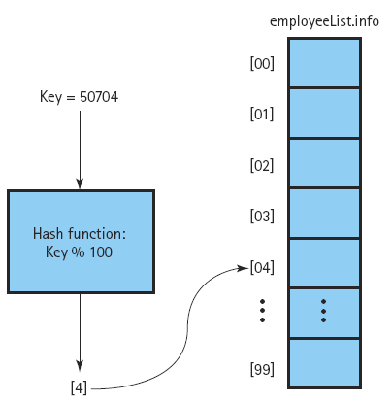
Introduction (cont)
EXAMPLE: (cont)

Slide 8
Collisions
Collisions
The condition resulting when two or more keys produce the same hash location.
For EXAMPLE,
ID number 01234 and ID number 91234 both "hash" to the same location: list.info[34].

Slide 9
Collisions (cont)
The problem of avoiding these collisions represents the biggest challenge in designing a good hash function.
A good hash function minimizes collisions by spreading the elements uniformly throughout the array.
Minimizes collision means that it is extremely difficult to avoid them completely.

Slide 10
Linear Probing
A simple approach to resolving collisions is to store the colliding element in the next available space.
Linear Probing
Resolving a hash collision by sequentially searching a hash table beginning at the location returned by the hash function.

Slide 11
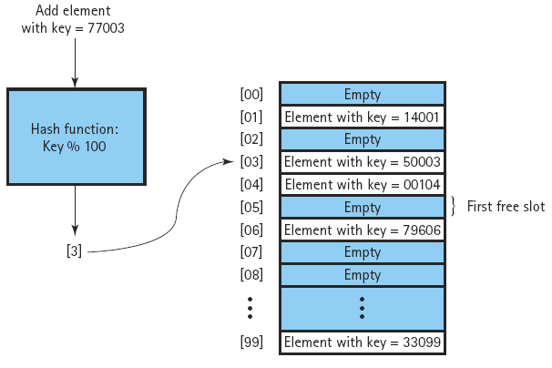
Linear Probing (cont)
For EXAMPLE
Add key ID number 77003.
The hash function return 3.
There is already an element stored in this array slot, the record for Employee 50003.
Increment location to 4 and examine the next array slot.
The list.info[4] entry is also in use, so we increment location again.
Store the new element into list.info[5]

Slide 12
Clustering
One problem with linear probing is that it results in a situation called clustering.
A good hash function produces a uniform distribution of indexes throughout the array's index range.
Initially, therefore, records are inserted throughout the array, with each slot being equally likely to be filled.
  Overtime, after a number of collisions have been resolved, the distribution of records in the array becomes less and less uniform.
  The records tend to cluster together, as multiple keys begin to compete for a single hash location.

Slide 13
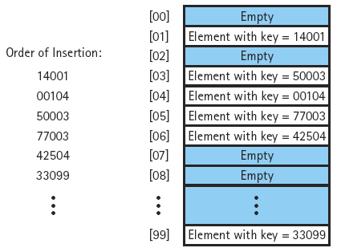
Clustering (cont)
For EXAMPLE,
Only a record whose key produces the hash value 8 would be inserted into array slot[8].
However, any records with keys that produce the hash values 3, 4, 5, 6, or 7 would be inserted into array slot[7].
That is, array slot [7] is five times a likely as array slot [8] to be filled. clustering results in inconsistent efficiency of insertion and retrieval operations.

Slide 14
Rehashing
The technique of linear probing is an example of collision resolution by rehashing.
Rehashing
Resolving a collision by computing a new hash location from a hash function that manipulates the original location rather than the element's key.
Rehash functions that use linear probing DO NOT eliminate clustering.

Slide 15
Rehashing (cont)
For rehashing with linear probing, you can use any function
(HashValue + constant) % array-size
as long as constant and array-size are relatively prime-that is, if the largest number that divides both of them evenly is 1.
For EXAMPLE, given the 100-slot array, we might use the constant 3 in the rehash function:
(HashValue + 3) % 100

Slide 16
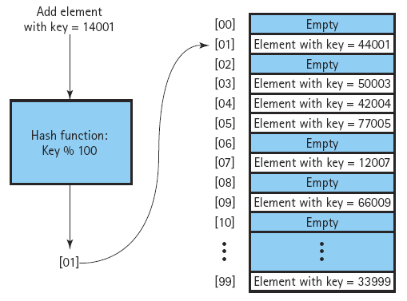
Rehashing (cont)
For EXAMPLE,
Add key 14001
Original hash function (key%100) returns the hash value 1.
Slot already used by 44001.
First rehash: (1+3)%100 = 4
Second rehash: (4+3)%100 = 7
Third rehash: (7+3)%100 = 10
Why the constant and the number of array slots must be relatively prime?
Supposed: (HashValue+2)%100

Slide 17
Rehashing (cont)
Quadratic probing
  Resolving a hash collision by using the rehashing formula (HashValue ± I²) % array-size, where I is the number of times that the rehash function has been applied.
  The first rehash adds 1 to HashValue,
  the second rehash subtracts 1 from HashValue,
  the third rehash adds 4,
  the fourth subtracts 4, and so on.

Slide 18
Rehashing (cont)
Random probing
  Resolving a hash collision by generating pseudo-random hash values in successive applications of the rehash function.
  Random probing is an excellent technique for eliminating clustering, but it tends to be slower than the other tehcniques.

Slide 19
Rehashing (cont)
Bucket
A collection of elements associated with a particular hash location.
Chain
A linked list of elements that share the same hash location.

Slide 20
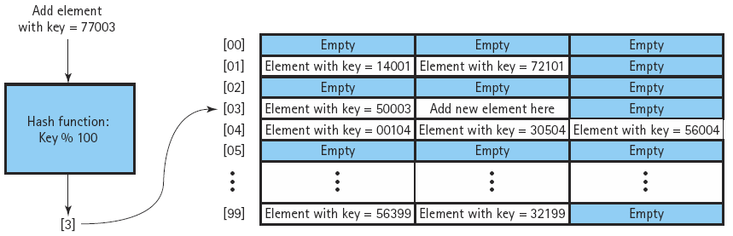
Rehashing (cont)
EXAMPLE:
  A hash table with buckets that can hold three elements each.
  Using this approach, we can allow collisions to produce duplicate entries at the hash location, up to a point.
  When the bucket becomes full, we must again deal with the problem of handling collisions.

Slide 21
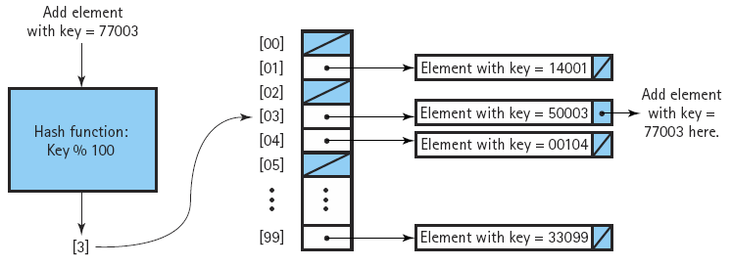
Rehashing (cont)
Handling collisions by hashing with chaining.

Slide 22
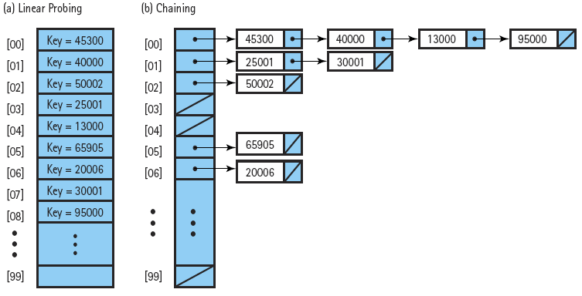
Rehashing (cont)
Another advantage of chaining is that it simplifies the deletion of records from the hash table.
The node can be deleted from this chain using the linked-list algorithm.

Slide 23
Folding
Folding
A hash method that breaks the key into several pieces and concatenates or exclusive-ORs some of the pieces to form the hash value.
For EXAMPLE,
Suppose we want to devise a hash function that results in an index between 0 and 255, and the internal representation of the int key is a bit string of 32 bits. We know that it takes 8 bits to represent the 256 index values (2⁸ = 256).

Slide 24
Folding (cont)
A folding algorithm to create a hash function might:
  Break the key into four bit strings of 8 bits each,
  Exclusive-OR the first and last bit strings,
  Exclusive-OR the two middle bit strings, and
  Exclusive-OR the results of steps 2 and 3 to produce the 8-bit index into the array.

Slide 25
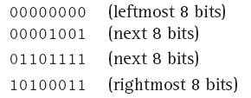
Folding (cont)
EXAMPLE:
Key 618403. The binary representation of this key is
00000000000010010110111110100011
  We break this bit string into four 8-bit strings:

Slide 26

Folding (cont)
EXAMPLE: (cont)
  The next step is to exclusive-OR the first and last bit strings.
    The exclusive OR of two bits is 0 if the two bits are the same,
    and 1 if they are different.

Slide 27
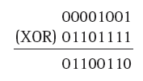
Folding (cont)
EXAMPLE: (cont)
  Next, we exclusive-OR the middle two bit strings:

Slide 28

Folding (cont)
EXAMPLE: (cont)
  Finally, we exclusive-OR the results of the preceding two steps:
  This binary number is equivalent to the decimal number 197, so the key 618403 hashes into index 197.

Slide 29
Radix Sort
The radix sort is NOT a comparison sort; that is, the algorithm does not compare two items in a list.
The radix sort is to sorting as hashing is to searching.
Radix
The number of possibilities for each position; the digits in a number system.
The idea behind the radix sort is to divide the values to be sorted into as many subgroups as there are possible alternatives for each position in the key.

Slide 30
Radix Sort (cont)
For EXAMPLE,
  If the key is an integer number, each position is a digit and has ten possibilities: 0..9.
  If the key is a string of letters and case is not important, then each position has 26 posiibilities: "a".."z".
  Let's illustrate this algorithm by sorting three-digit positive integers. Within a three-digit number, let's refer to the ones, tens, and hundreds positions as positions 1, 2, and 3, respectively. We divide the values into ten subgroups based on the digit in the ones position.

Slide 31
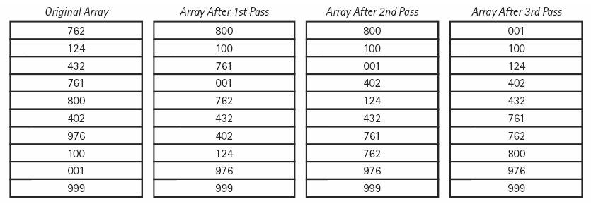
Radix Sort (cont)
Array after each pass

Slide 32
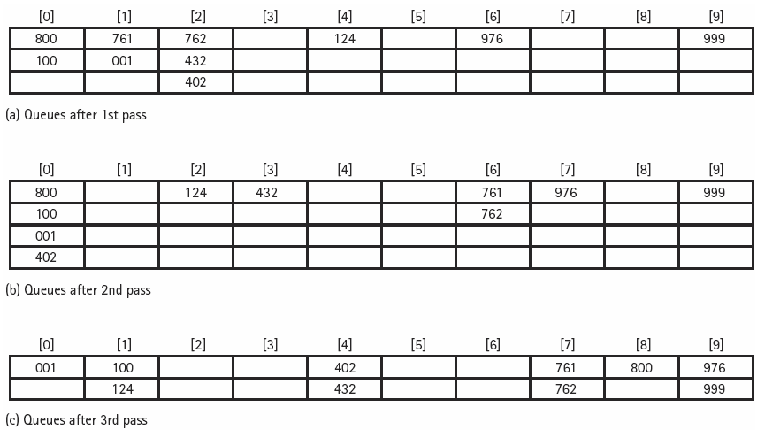
Radix Sort (cont)
Queues after each pass

Slide 33
Exercises
Write a program to demonstrate Linear Probing.
Hash Function: (Key%100)

